Slide 1




Slide 2

POWER CYCLE

Slide 3


Test time on : SI & CI
QR CODE:

Slide 4
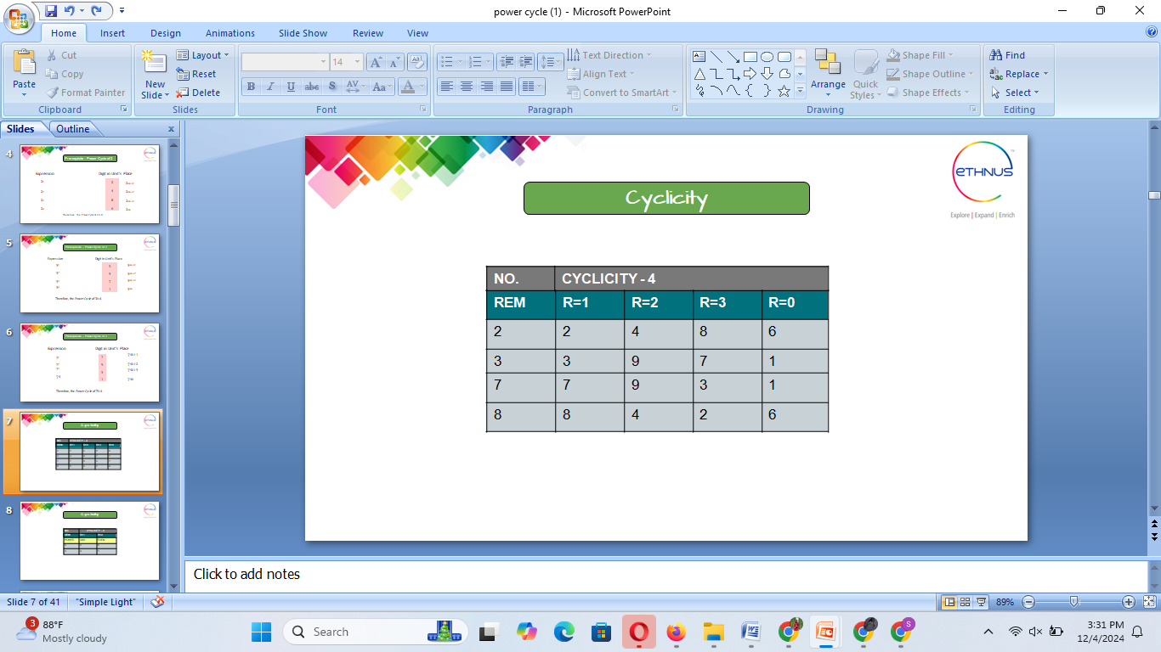
CYCLICITY

Slide 5
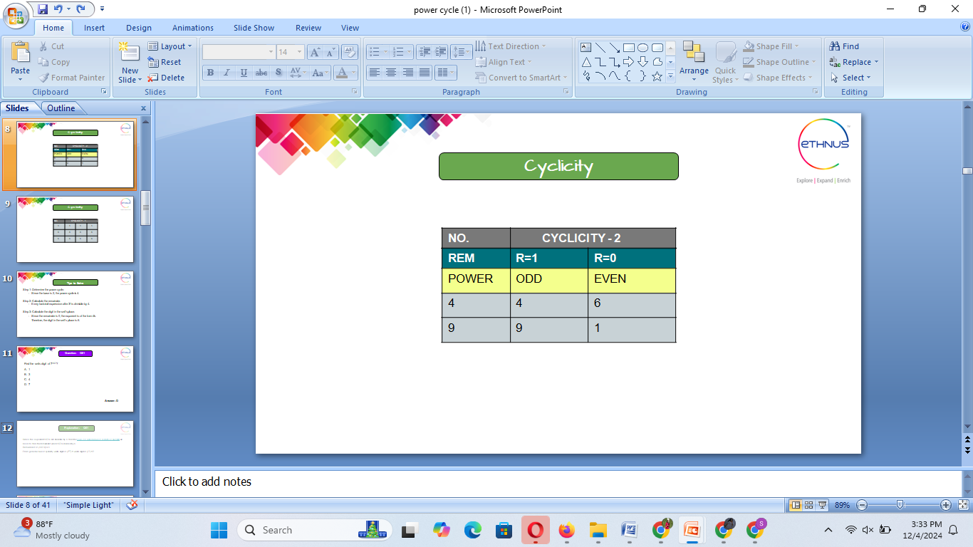
CYCLICITY

Slide 6
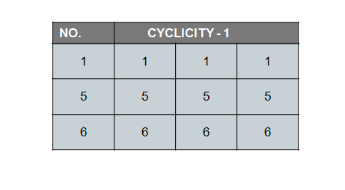
CYCLICITY

Slide 7
NUMBER PROPERTIES
POWER CYCLE

Slide 8
Question: 01
Find the units digit of 7¹⁵⁷?
A.1
B.3
C.4
D.7
Answer: A

Slide 9
Explanation: 01
Since the exponent 157 is not divisible by 4, from the case 2 of general rule of cyclicity of numbers, we need to find the remainder when 157 is divided by 4
Remainder of (157/4) is 1.
From general rule of cyclicity, units digit of (7¹⁵⁷) = units digit of (7¹) = 7

Slide 10

Question: 02
What is the units digit in the product (3⁶⁵ * 6⁵⁹ * 7⁷¹⁰)?
A.1
B.2
C.4
D.6

Slide 11
Explanation: 02
●We know that units digit of (3⁶⁵ * 6⁵⁹ * 7⁷¹) = Units digit of (Units digit of (3⁶⁵) * Units digit of (6⁵⁹) * Units digit of (7⁷¹) )
●Units digit of 3⁶⁵
From the general rule of cyclicity of numbers we know that, if exponent of a^{b} is not divisible by 4 then cyclicity of a^{b} = cyclicity of a^{r} where r is the remainder of b/4
Remainder of (65/4) = 1
Units digit of (3⁶⁵) = units digit of (3¹) = 3
●Units digit of 6⁵⁹
Same as above, remainder of (59/4) = 3 Units digit of(6⁵⁹) = units digit of (6³) = 6
●Units digit of 7⁷¹
Remainder of 71/4 = 3
Units digit of 7⁷¹ = units digit of 7³ = 3
●Units digit of 3⁶⁵ * 6⁵⁹ * 7⁷¹ = Units digit of ( 3 * 6 * 3) = 4

Slide 12
Question: 03
What is the units digit in(7⁹⁵ - 3⁵⁸) ?
A.0
B.4
C.6
D.7

Slide 13
Explanation: 03
●We need to find the units digit of 7⁹⁵ and 3⁵⁸ separately. Let’s use the general rule of cyclicity to find these.
●Units digit of 7⁹⁵
Remainder of 95/4 = 3
Units digit of 7⁹⁵ = Units digit of (7³) = 3
●Units digit of 3⁵⁸
Remainder of 58/4 = 2
Units digit of 3⁵⁸ = Units digit of (3²) = 9
Unit digit in (7⁹⁵ - 3⁵⁸) = Unit digit in (7⁹⁵) - Unit digit in (3⁵⁸) = 13 – 9 = 4

Slide 14

Question: 04
What is the units digit of (6374)¹⁷⁹³ x (625)³¹⁷ x (341)⁴⁹¹ ?
A.0
B.2
C.3
D.5

Slide 15
Explanation: 04
●We need to find the unit place digit of each term separately.
●Units digit in (6374¹⁷⁹³)
We know that units digit of (6374¹⁷⁹³) = units digit of 4¹⁷⁹³
Since 1793 is odd, we know that reminder of 1793/4 will be an odd number
Since cyclicity of 4 is 2, and the units digit at odd positions are 4.
Hence units place digit of (6374¹⁷⁹³) = 4
●Units digit in (625³¹⁷)
From the table of cyclicity of numbers we know that 5 has cyclicity 1 and value is 5
●Units digit in (341⁴⁹¹)
From the table of cyclicity of numbers we know that 1 has cyclicity 1 and value is 1
●Hence units digit of (6374)¹⁷⁹³ x (625)³¹⁷ x (341)⁴⁹¹ = Units digit of (4 * 5 * 1) = 0

Slide 16
Question: 05
Find the units digit of 33⁴³ + 43³³ ?
A.0
B.3
C.7
D.9

Slide 17
Explanation: 05
●We know that units digit of (33⁴³ + 43³³ ) = units digit of (units digit of 33⁴³ + units digit of 43³³)
Now let's find units digit of each term separately.
●Units digit of 33⁴³
Since exponent 43 is not divisible by 4, from the general rule of cyclicity of numbers, we know that
Units digit of 3⁴³ = Units digit of 3³ [3^{reminder of 43/4}]
= 7
●Units digit of 43³³
Similar to above scenario
Units digit of 3³³ = Units digit of 3¹ [3^{(reminder of 33/4)}]
= 3
Hence units digit of 33⁴³ + 43³³ = Units digit of (7 + 3) = 0

Slide 18

Question: 06
What is the digit expected at units place of following mathematical operation:
( 6¹⁵ - 7⁴ - 9¹³ )?
A.0
B.2
C.4
D.6

Slide 19
Explanation: 06
●Last digit of 6¹⁵
6 has cyclicity 1, hence last digit of 6¹⁵ = 6
●Last digit of 7⁴
Since the exponent is divisible by 4, from the table of cyclicity of numbers, we get last digit of 7⁴ = 1
●Last digit of 9¹³
As we know, 13 is odd number and so the the remainder of 13/4 is also odd.
From the table of cyclicty of numbers, we know 9 has a cyclicity of 2 athe the element at odd positions of cyclicity is 9.
Hence unit's last digit of 9¹³ = 9
Hence, last digit of 6¹⁵ - 7⁴ - 9¹³ = Last digit of ( last digit of ( 6¹⁵) - last digit of ( 7⁴ ) - last digit of ( 9¹³ ))
= Last digit of (16 - 1 - 9) = 6

Slide 20
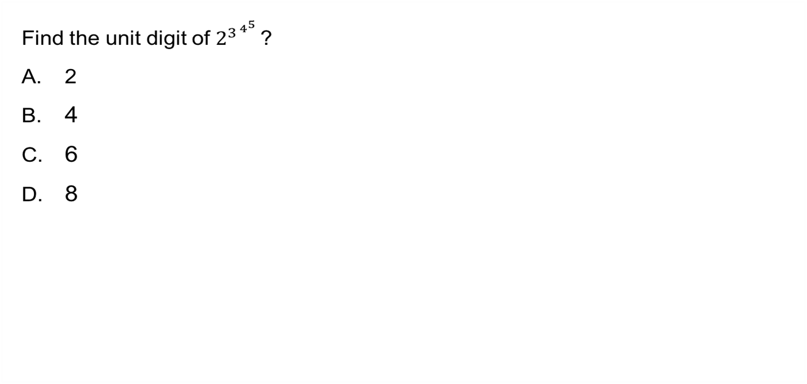

Question: 07

Slide 21
Explanation: 07
As in the other problems, here also we need to find the remainder when the exponent is divided by 4 That is, remainder of 3^{4^5}/4 We can re write it as remainder of (4 - 1)^{4^5}/4 As explained the number cyclicity tutorial (using binomial theorem), we can see that remainder of (4 - 1)^{4^5}/4 = 1 The 1st digit in the cyclicity of 2 is 2, hence the unit digit of 2^{3^4^5} = 2

Slide 22
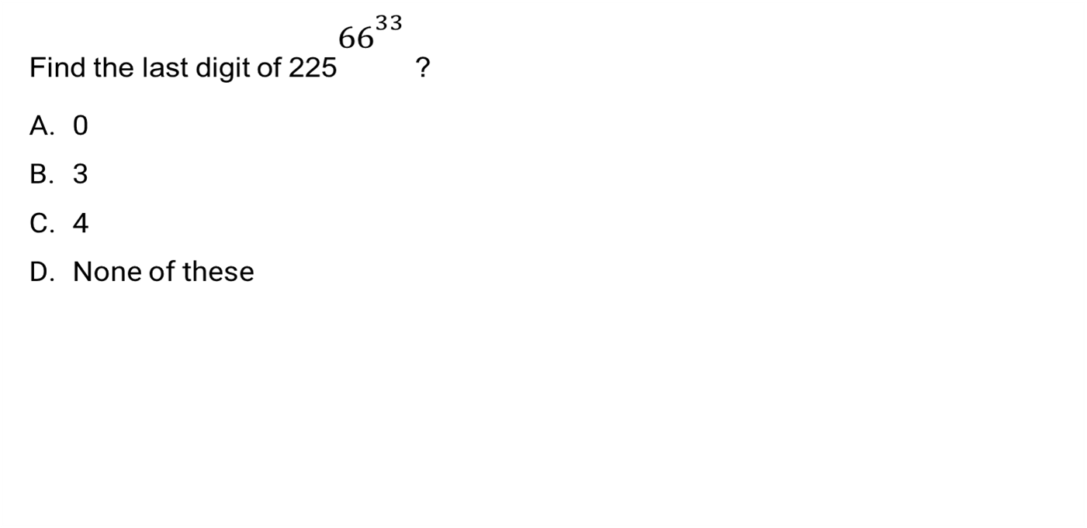
Question: 08

Slide 23
Explanation: 08
Since 5 has cyclicity 1 and the value is 5, we don't need to any calculations to find it's answer. Unit's digit of 225^{66^33} is 5

Slide 24
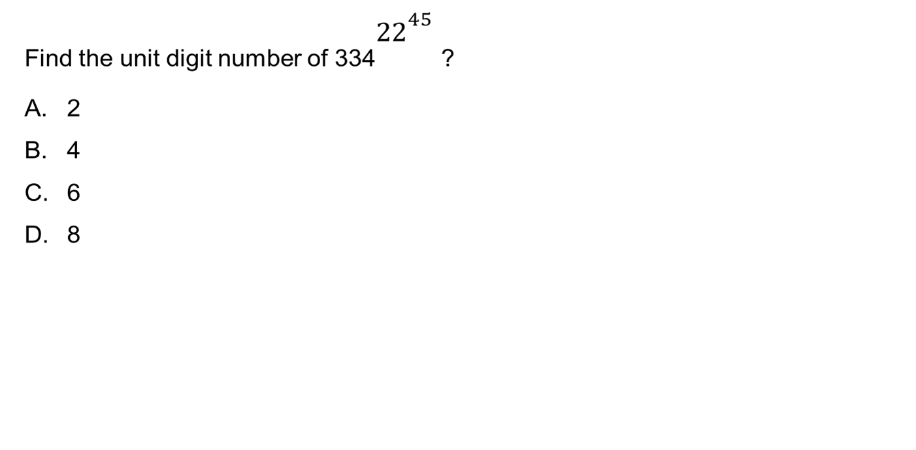
Question: 09

Slide 25
Explanation: 09
It's similar to the previous problem. Since 4 has cyclicity 2, we only need to find if the exponent 22⁴⁵ is even or odd. We know when an even is raised to any power result will be an even number. So the unit digit number will be the one occurring at the even positions of cyclicity of 4 which is 6

Slide 26

Question: 10

Slide 27
Explanation: 10
We know that cyclicity if 9 is 2 and the values are 9 and 1. In this problem as explained the tutorial, we only need to find if the exponent 53⁵ is even or odd because the last digit is same for even and odd positions of the cyclicity. We know that an odd number raised to any power be an odd number. Hence the units digit number will be the cyclicity that occurs at odd positions, which is 9

Slide 28

Question: 11

Slide 29
Explanation: 11
As we know the last digit depends upon the unit digit of the multiplier numbers so the unit digit of 13⁴¹
is same as the last digit of 3⁴¹ and we know that the cyclicity of 3 is 4
On dividing the number 41 with 4 and we will get the remainder as 1 and the last digit will be 3¹ = 3

Slide 30

Question: 12

Slide 31
Explanation: 12
As we know the last digit depends upon the unit digit of the multiplier numbers so the unit digit of 13⁴¹ is same as the last digit of 3⁴¹ and we know that the cyclicity of 3 is 4 On dividing the number 41 with 4 and we will get the remainder as 1 and the last digit will be 3¹ = 3

Slide 32
Question: 13
What will be the unit digit of 45⁴⁵ ?
A.5
B.0
C.1
D. 9

Slide 33
Explanation: 13
Here the last digit is depend upon the 5 The cyclicity of 5 is 1 so there is no need to divide the power with 1 because whatever is the power of 5 the last digit will remains 5 so the last digit of 45⁴⁵ will be 5 . 5¹ = 5 5² = 25 5

Slide 34

Question: 14
What will be the last digit of 3⁴ x 4⁵ x 5⁶ ?
A.0
B.9
C.3
D.7

Slide 35
Explanation: 14
Last digit of 3⁴ = 1 Last digit of 4⁵ = 4 Last digit of 5⁶ = 5 So as we discussed earlier that the last digit depends upon the last digits So 1 x 4 x 5 = 20 so the last digit is 0; also whenever 5 is multiplied by even number then last digit will be 0

Slide 36
Question: 15
Identify the last digit of (79⁴ + 87⁵)?
A.8
B.0
C.7
D.4
Answer: A

Slide 37
Explanation: 15
●Last digit of 79⁴ is depends upon the the 9⁴ i.e 1
Last digit of 87⁵ is depends upon the the 7⁵i.e 7
So the last digit of the whole expression will be 1 +7 = 8
So the last digit will be 8

Slide 38

https://learn.codemithra.com

Slide 39




THANK YOU
+91 78150 95095
codemithra@ethnus.com
www.codemithra.com

